Slide 1
Spring Project
Spring Core With Maven
(Maven Quick Start)

Slide 2
Steps
Create Maven Quick Start Project
Add Spring Dependencies in POM
Create a class ( say Category )
Configure the beans
Write Bean.xml ( Optional)
Annotations( We are using)
Test it

Slide 3
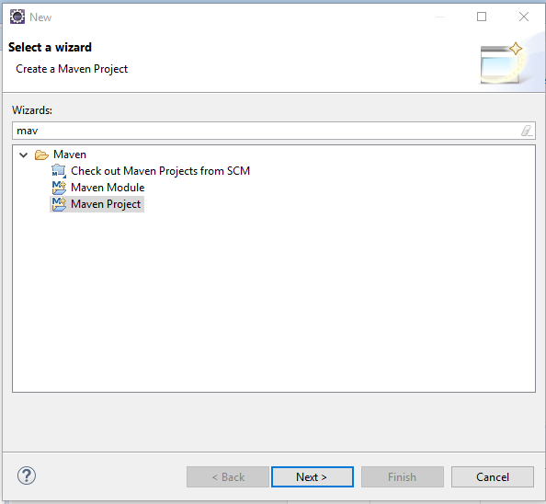
Create new Maven Project

Slide 4
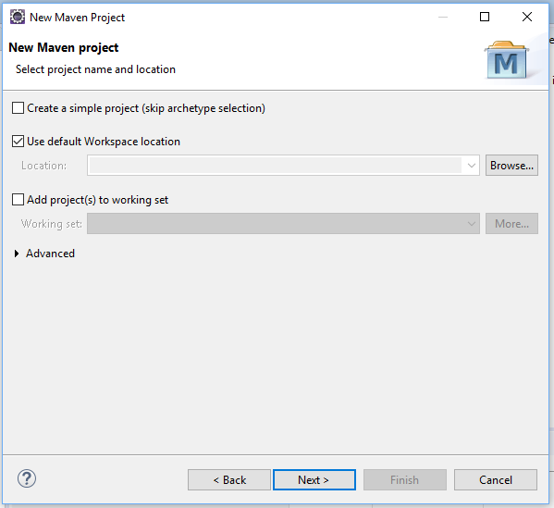
Click Next

Slide 5
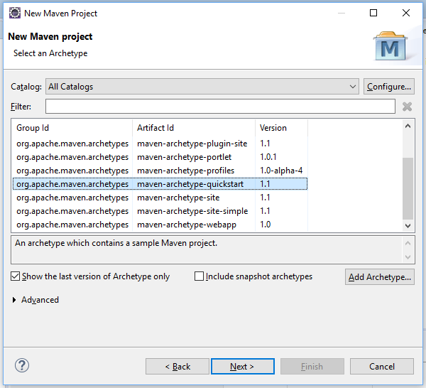
Select Archetype

Slide 6
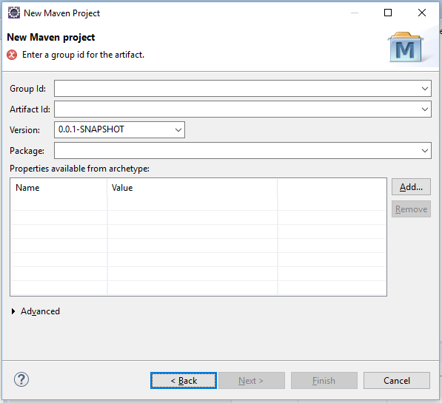
Enter the details

Slide 7
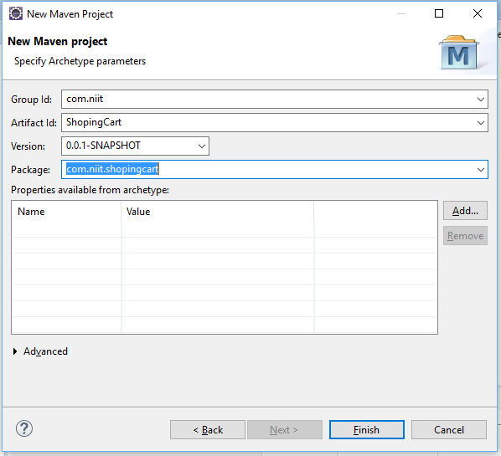

Slide 8
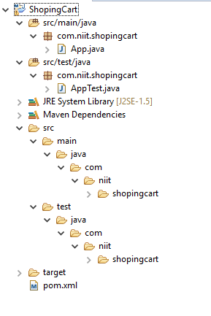
Project / Package Structure

Slide 9
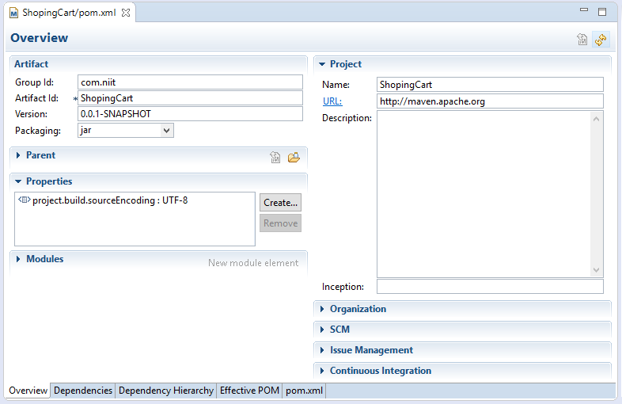
POM

Slide 10
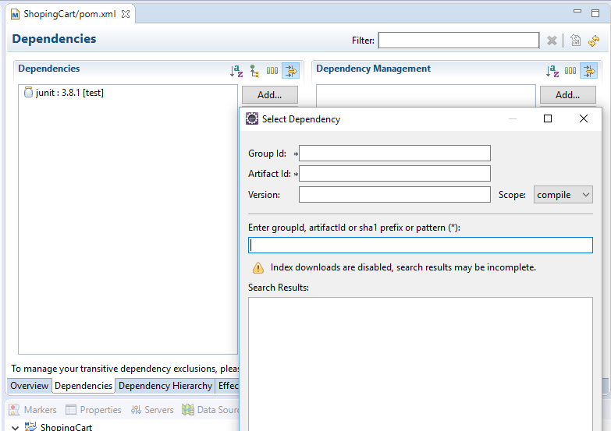
Dependencies

Slide 11
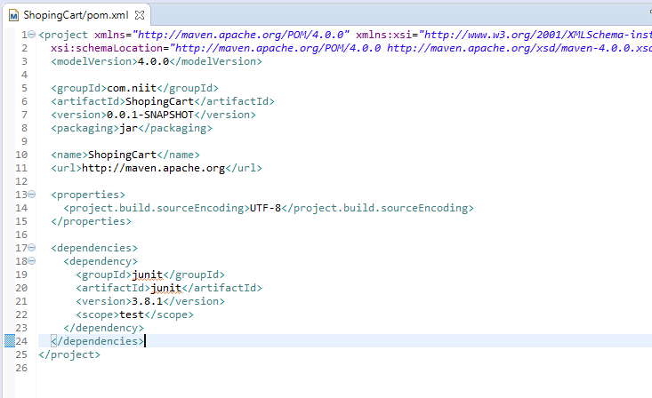
pom.xml

Slide 12
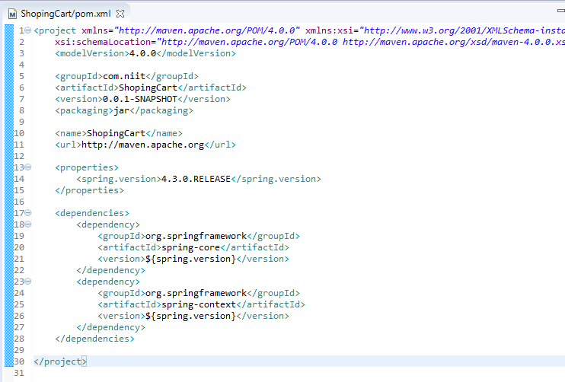
Add Spring Dependencies

Slide 13
Where I can get dependencies?
http://mvnrepository.com
Search for groups/artifacts/categories

Slide 14
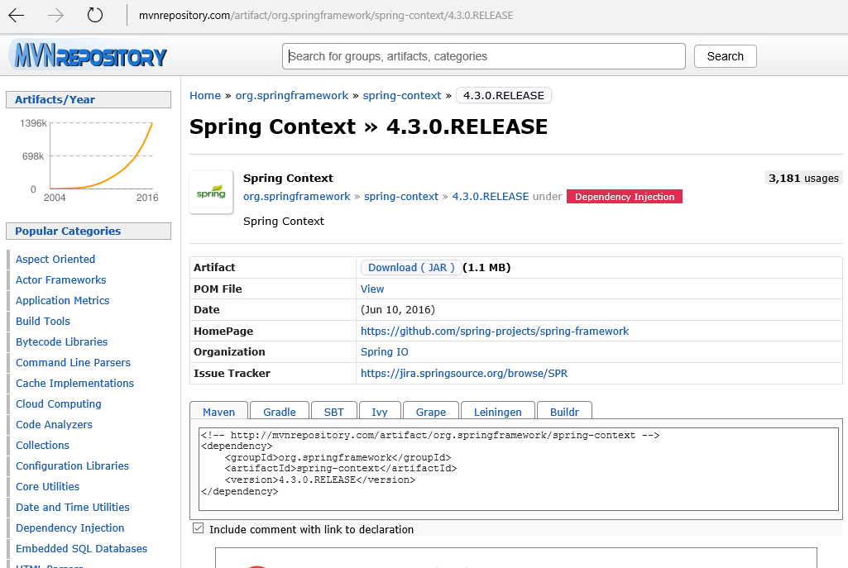

Slide 15
Write your own class

Slide 16
Category Class
Create Category class
Generate Setter/Getter methods

Slide 17
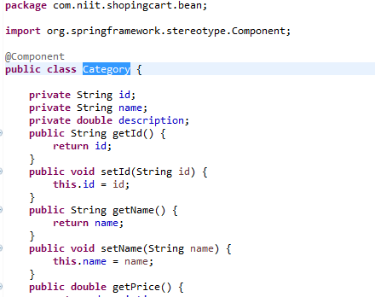
Annotation

Slide 18
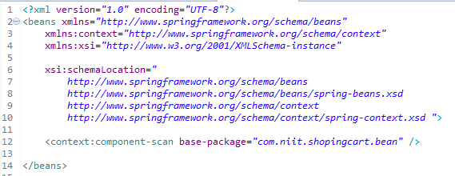
Bean.xml ( Optional )

Slide 19
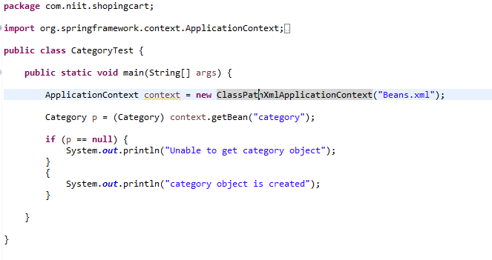
Test

Slide 20
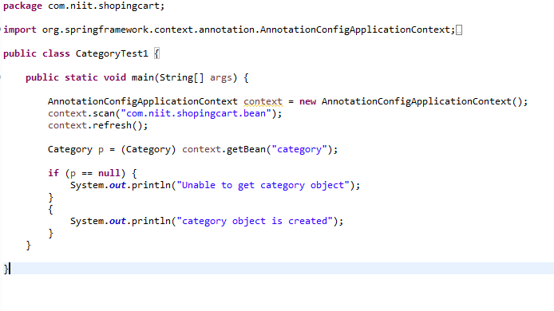
Test – without beans.xml

Slide 21
Differences XML based vs Annotation

Slide 22
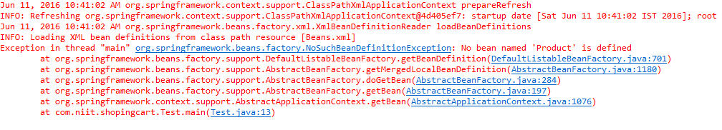
Error

Slide 23
Using MVN Command prompt
mvn archetype:generate
-DgroupId=com.mycompany.app
-DartifactId=my-app -DarchetypeArtifactId=maven-archetype-quickstart -DinteractiveMode=false

Slide 24
Dependency Injection

Slide 25
We have written Category Class
Now write Product Class
Note : Product class is depends on Category.

Slide 26
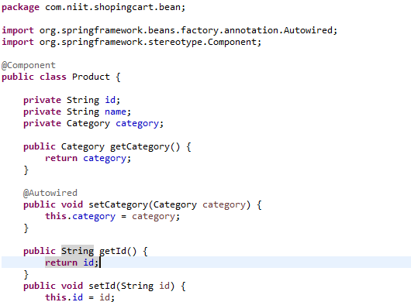
Product Class

Slide 27
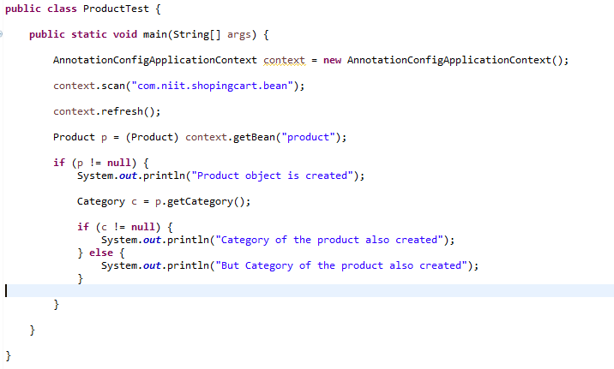
Test Product

